Slide 1
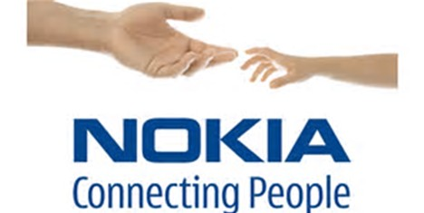

Slide 2
BACKGROUND
Nokia Corporation. stylized as NOKIA, is a Finnish multinational communication and information technology company, founded in 1865.
Nokia is headquartered in Espoo, in the greater Helsinki metropolitan area.
It was the world's 274th-largest company measured by 2013 revenues according to the Fortune Global 500.

Slide 3
FINANCIAL ANALYSIS
Nokia reports financial results for four operating segments:
Mobile Phones
Multimedia
Enterprise Solutions
Networks

Slide 4
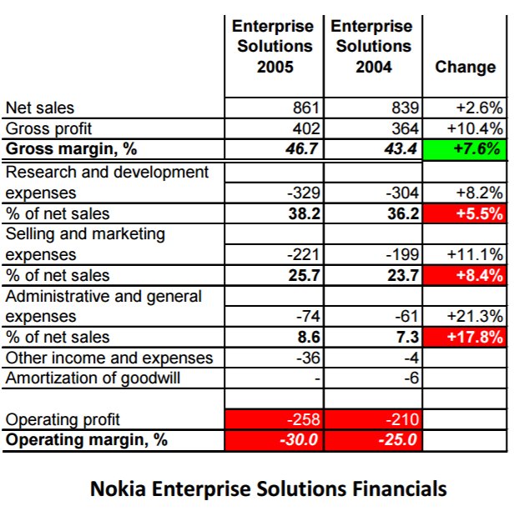
NOKIA TURNED A €4.6 BIL OPERATING PROFIT ON €34.2 BIL REVENUE IN 2005 (OPERATING MARGIN OF 13.6%), UP FROM €4.3 BIL OPERATING PROFIT ON €29.4 BIL REVENUE IN 2004 (OPERATING MARGIN OF 14.7%).
A glance at the relevant section of Nokia’s 2004 financials suggest that, if Enterprise Solutions is expected to turn a profit in the future, it may wish to get started already.
Three of Nokia’s divisions combined to record total operating profits of €4.5bil and €4.9bil in 2004 and 2005, respectively.
One division, Enterprise Solutions, had operating losses of €210mil and €260 in those same periods.

Slide 5
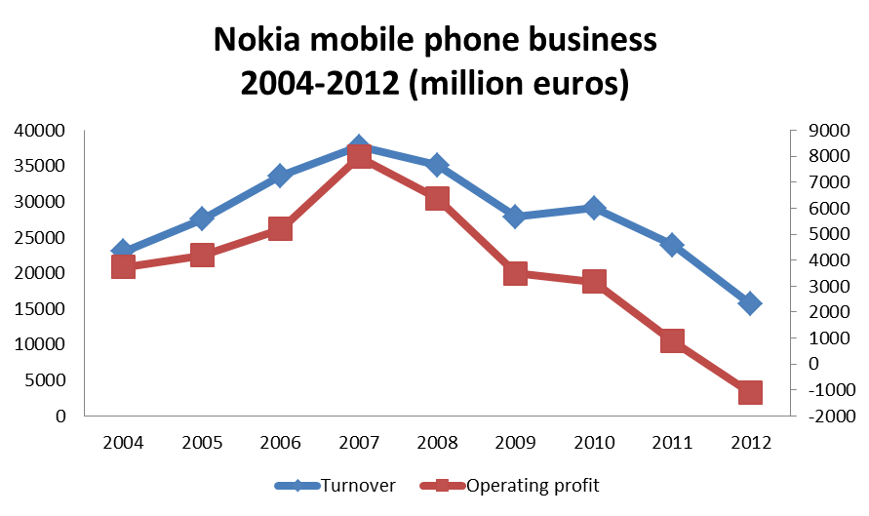
As seen NOKIA was a leader in Mobile Industry till 2007 with wide range of devices.
Now Nokia phones are no more the preferred brand of consumers and newer brands like the South Korean Samsung or the home-grown Micromax have eaten into its once dominant market share.
This has become clearer with the company’s declining revenue and profitability in the last few years.

Slide 6
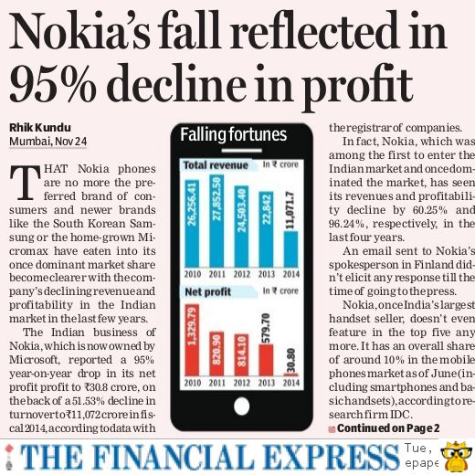
AS STATED IN FINANCIAL EXPRESS IN 2014…..

Slide 7
IN 2014, MICROSOFT PURCHASED NOKIA AND LAUNCHED ITS OWN LUMIA HANDSETS ALONG WITH SELECT HANDSETS OF NOKIA PHONES.
The outlook for Nokia was pretty grim yesterday, with one analyst saying that the company was looking at a "disastrous third quarter". Then, everything changed when Microsoft announced that it would purchase Nokia's Devices and Services division for $7.17 billion (including patent licensing). So, it's really no surprise that today was a huge day for Nokia stock.
Right out of the gate, Nokia's stock skyrocketed. At its peak today, the stock was up 45% from yesterday's closing price of $3.90 per share. At the end of the day, Nokia's stock closed up 31% at $5.12 per share.

Slide 8
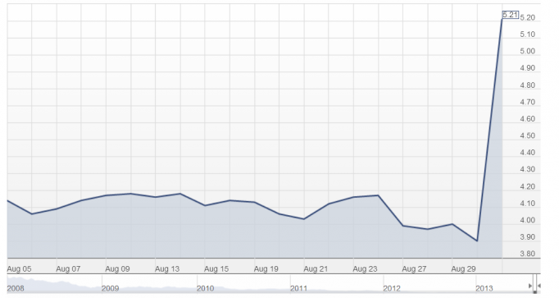
AFTER MICROSOFT ACQUIRED NOKIA
However, in May 2016, Microsoft sold its feature phone handsets (including Nokia brand) to Foxconn. Foxconn is relaunching Nokia in 2016. Microsoft will continue with Lumia handsets and Microsoft OS which are in partnership with Acer and Alcatel. Nokia is supposed to relaunch with Android OS.

Slide 9
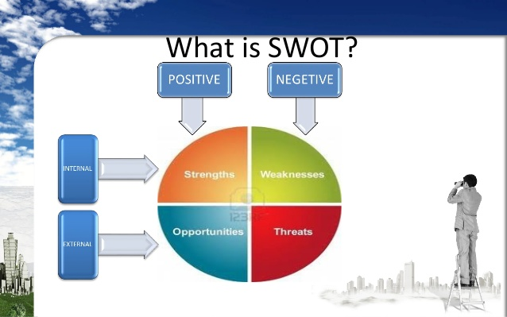
SWOT Analysis of NOKIA

Slide 10

STRENGTHS
Brand Name: NOKIA has 142 years of history and has been top brand in market industry for its reliability and durability.
Most of Nokia’s highly qualified personnel have teamed up with Microsoft’s experts as a part of the acquisition deal.
Much Higher Resale Value compared to other mobile phone brands.
Strong financial support for R&D (1.4 billion USD) – to maintain its user base and keep them happy.
User friendliness: Many of Nokia’s products are easy to use and are usually coupled with a variety of handy accessories.
Largest network of selling & distribution – It has fantastic distribution and reach across countries.
Products offered in all price ranges.

Slide 11

WEAKNESSES
Poor after sales services - very few service centers.
Took a long time to enter the highly productive and booming smartphone market. As a result the company lost a lot of its once huge market share.
Some of Nokia’s products are not affordable for middle and lower class consumers, which often affects their searches negatively.
Low promotion undertaken to target the lower class of society.
There are slumps in the company’s development with its Windows Lumia range of smartphones because of constant competition from rivals Android and iOS.

Slide 12

OPPORTUNITIES
The Microsoft-Nokia deal is a win-win situation for both companies. The deal possesses great opportunity if both utilize resources in a proper way.
Opportunities to expand the range of products and their prices. Also bring in new features and applications on Windows OS.
Well designed and styled sets.
Increase their presence in 3G & edge market.
Improvise on quality of camera.
Mini notebooks.

Slide 13

THREATS
Strong competition from other smartphone companies will make it hard for Nokia to maintain and expand their market share.
Samsung and Iphone – Both of them had wiped out Nokia in 2014 and they will again challenge the phone in 2016 as well.
Low-cost threats by China mobile companies and others can cause big problems.

Slide 14
CONCLUSION
So, after proper SWOT analysis, we come to the conclusion that Nokia is going through a tough time in the market due to a variety of factors. However, with Microsoft and Nokia personnel teamed up, there is no doubt in saying that many of these problems can be overcome if Nokia strategizes, plans and uses its resources properly

Slide 15
CORPORATE SOCIAL RESPONSIBILITY OF NOKIA
“ The definition of CSR is that CSR is about how companies manage the business processes to produce an overall positive impact on society. " (Mallen Baker, 2010)

Slide 16
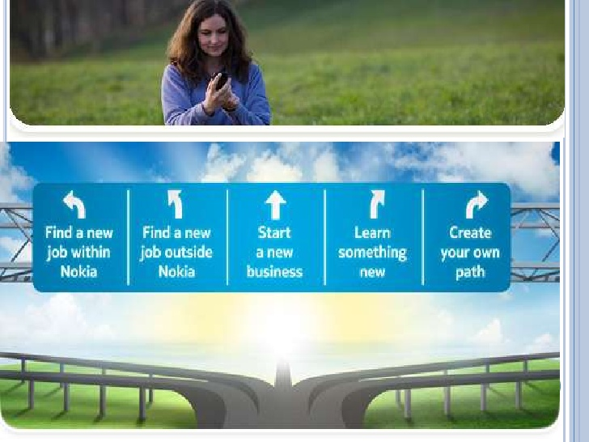
RE-EMPLOYMENT

Slide 17
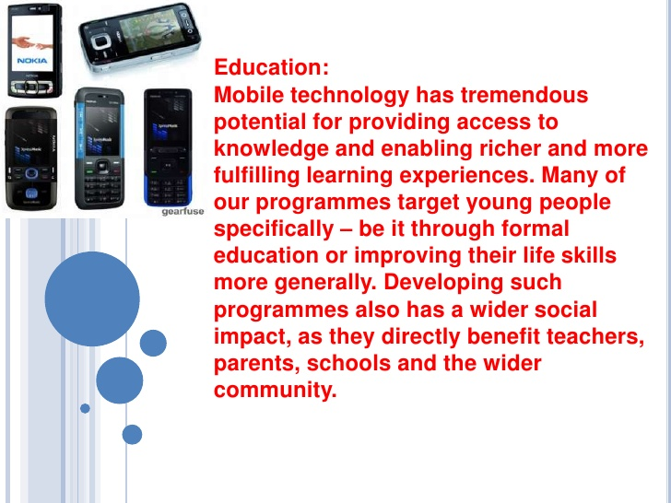
EDUCATION
NOKIA expands its mobile Mathematics pilot to FINLAND.

Slide 18


HEALTH
NOKIA took an initiative to partner with OXFAM to improve maternal health in low-income countries.

Slide 19
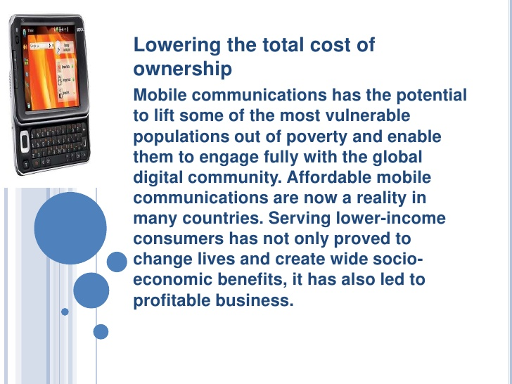
LOWERING THE COST OF OWNERSHIP

Slide 20
HUMAN RESOURCES
Recruiting process
Apply online through online application
Company’s hiring management reviews applicant’s skills
The selection process consists of multiple rounds starting from phone interviews and onsite interviews with hiring managers, peers and HR team
A member from the HR recruiting team is always in touch with the candidate to keep them updated on their status, both at interim and final stages

Slide 21
HRM RETAINING
TRAINING AND DEVELOPMENT
Fun, creates commitment, passion and inspiration
Encourages open discussions and debate
Programs like ‘Listening to you’ and ‘ Ask HR’ was conducted
Operated on 70-20-10 approach to training
On-the-job learning (70%)
Mentoring & Individual coaching (20%)
Classroom training & e-learning (10%)
Active participation by trying new roles
Focus on performance evaluation and leadership

Slide 22
Rewarding employees
Award for good performance, competence development and for overall company success
Reward programs includes bonuses, individual performance, team and company results
Offers Equity programs to eligible employees

Slide 23
BENEFITS
Insurance (healthcare and life)
Transportation (free buses)
Gifts on special occasions( eg. Birthday, marriage)
Relocation support
Work related mobile phone
Education assistance

Slide 24
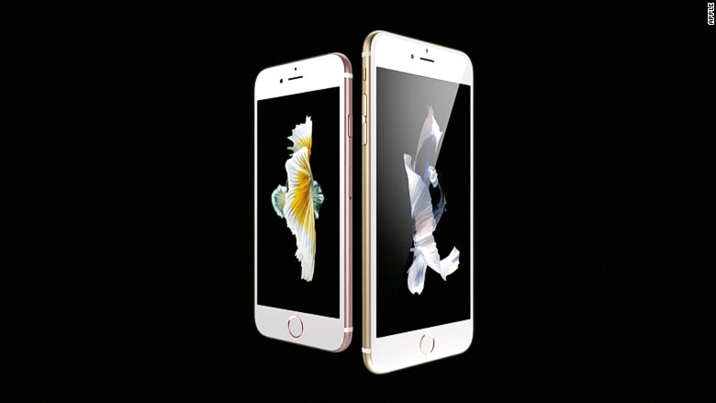
Organization Benchmark: Apple

Slide 25
A LITTLE HISTORY….
Let’s go back to 2006….
Apple was about to launch a phone that nobody in the mobile world thought they had much of a chance. The company was just being too ambitious. They were calling it the iPhone and it was due soon.
Nokia sold phones in the hundreds of millions, controlled supply chains and had the tightest relationships with carriers.
While Apple was designing the iPhone and Nokia was selling half a billion phones each year, Google bought a company called Android and announced an Open Handset Alliance, a grouping of industry players who would come together to build an open source OS for smartphones. Nokia was invited to join but refused to demean itself.

Slide 26
HISTORY CONT..
Soon after Apple launched an Apps Store that began to take off, attracting tens of thousands of developers, and then customers.
Within two years of these events Nokia was already in crisis. In 2007, Nokia had a market capitalization of €110 billion; by May 2012 this had fallen to €14.8 billion. Those figures illustrate the extent of the decline over 5 years, years in which Apple and Android came to dominate smartphones.
Nokia/Symbian also launched an Apps Store, Horizon, now happily forgotten, and after six months it had the sum total of 60 apps in it.
And Nokia launched its own Apps and Content store – Ovi, in 2009. But Nokia had no real platform experience to compare with Apple’s. The platform was shaky and it tried to launch simultaneously in 35 countries – because that’s what dominant players do. It was a disaster and the tech press called it out as such. Nokia was faced with a gale of criticism for the first time.

Slide 27
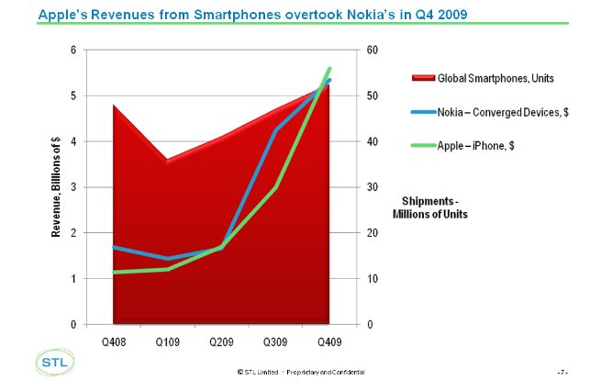
APPLE: HIT OF THE DECADE

Slide 28
REASONS FOR APPLE’S SUCCESS…
Significance to Leadership
Discovery of Untapped Resources
More Dedicated and Loyal Customer Base
Higher Profit Margins
Sustainable Competitive Advantage

Slide 29
SITUATIONAL ANALYSIS
Corporate Culture
“Word hard, play harder” Mentality.
World’s most admired company
Operations
The Organizational structure is very non-traditional.
Teams and Department Division.
Very informal and non-hierarchical.

Slide 30
MARKETING
Four P’s
Product
Supply Superior ease-to-use.
Seamless Integration.
Innovation Industrial Design.
Price
Value based pricing
Variable price for iTunes
Place
Distribution
Sales Force
On-line Sales
Promotion
“Test drive a Mac”– 1983
iPod as contemporary art
Celebrity involvement

Slide 31
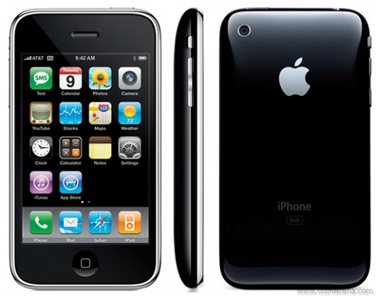
What Nokia was doing wrong ?
Year 2006
Nokia is on a high. It enjoys 60% share of mobile market and is the undisputed lead.
Year 2007
Apple launches iPhone 3s
Redefines smart phone & challenges category
leaders like BlackBerry and Nokia

Slide 32
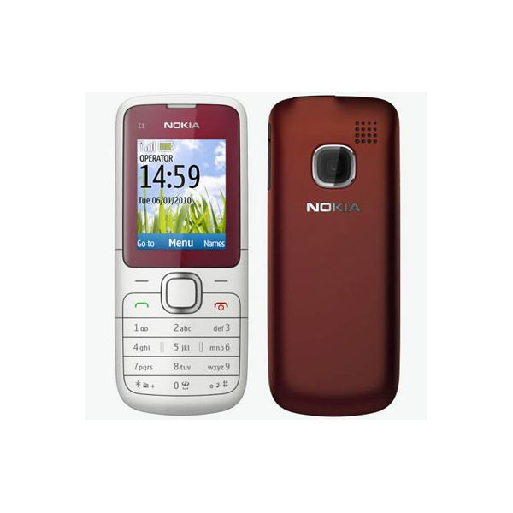
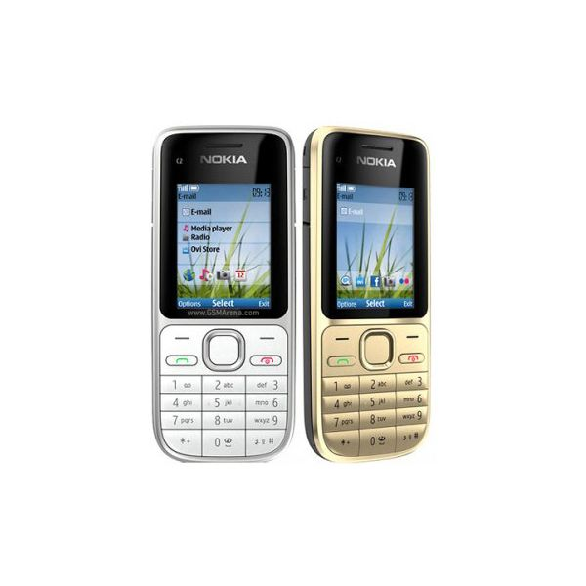
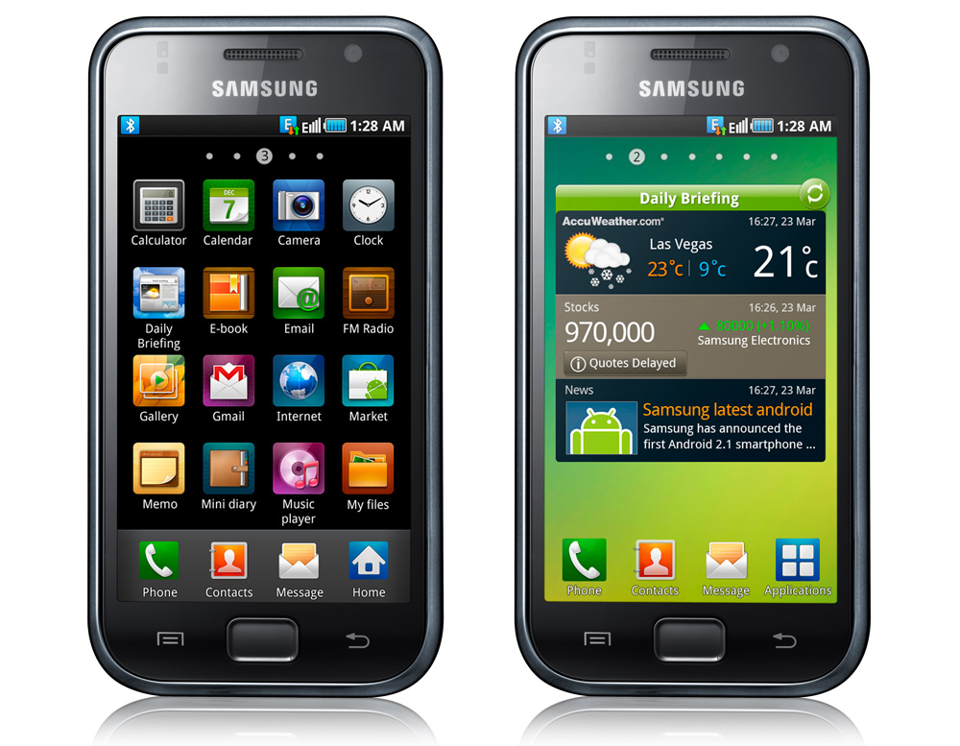
Year 2010
Samsung
Nokia
Galaxy S
Galaxy-3
Galaxy-5
C1 & C2—dual SIM phones

Slide 33
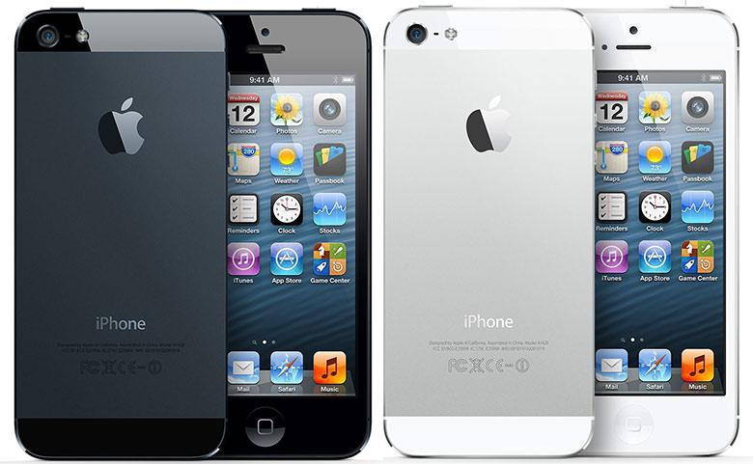
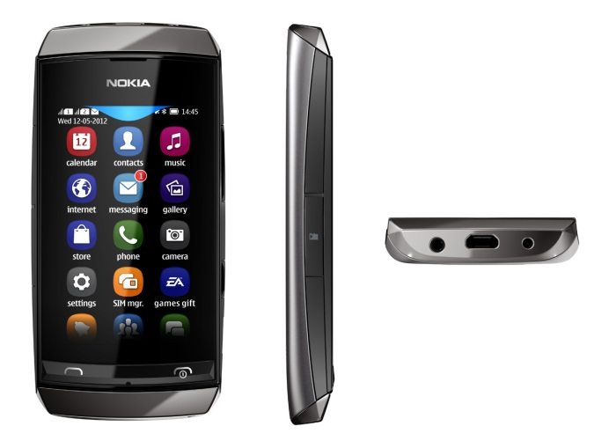
Year 2012
iPhone
Nokia
iPhone 5
Full-Touch Asha 305

Slide 34
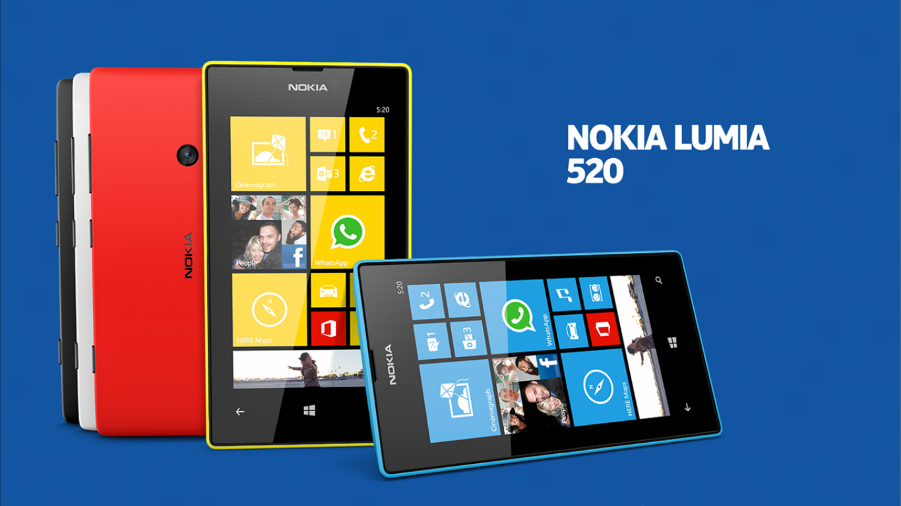
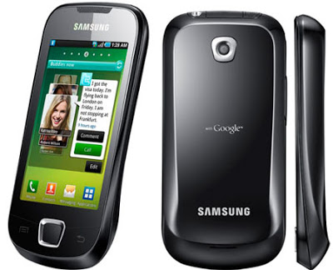
Year 2013
Other Cellphones
Nokia
iPhone 5s
Samsung launches cheap smartphones
Lumia 520

Slide 35
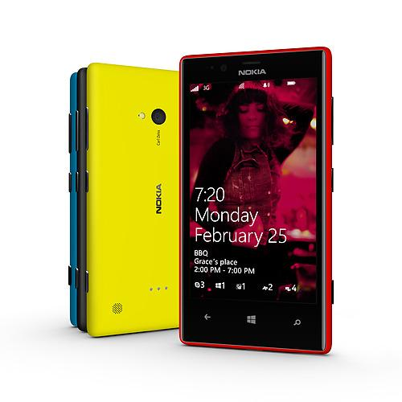
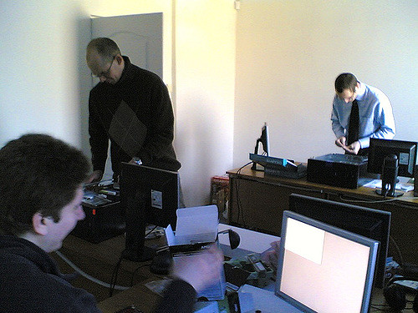
Reasons behind the failure of NOKIA and Recommendations
Innovation and Adapting to change
Problem
Solution
mobile phones into fashion accessories
h/w company rather than a s/w
Underestimated the importance of software
h/w and s/w as equally important parts
Priority to UX and UI
Employee Innovation session

Slide 36
2.Leadership
Nokia struggled
Stephen Elop was hired
They moved to Windows Phone
The situation became critical
Nokia’s survival was doubtful
They sold Devices & Services to Microsoft

Slide 37
Rumor Mill
Stephen Elop was working with Microsoft’s Business Division before moving to Nokia.
He was the first non-Finnish CEO of Nokia and it is argued that Stephen was sent with the sole purpose of devaluating Nokia as to make it easier and cheaper for Microsoft to buy it.
Microsoft being a software giant always had ambitions to acquire a hardware sector firm and as Nokia dipped to the bottom, Microsoft announced that it had bought Nokia for $7.2 Billion.
While all this happened, Stephen comes back to Microsoft as VP of Microsoft's Devices & Services business unit and gets a signing bonus of $25 Million

Slide 38
3. Inflexible management process
Identify and kill off the processes that no longer add any
value
Guide new initiatives outside the existing processes

Slide 39

4. Old and insufficient metrics
Define its relevant market as widely as possible
Measure customer behaviour very carefully
https://trianglesci.org/category/2016-institute/

Slide 40

5. Voiceless front line(salespeople,purchasing managers)
Technology-based systems for sharing front-line information
quickly
formal Informal networks
http://www.salesprorecruitment.co.uk/blog/category/top-sales-academy/

Slide 41

6. Lack of diversity
Hire people with different backgrounds,
ideas,age groups,cultures
https://craemerconsulting.com/2016/09/29/the-value-of-thought-diversity/

Slide 42
References
Birkinshaw,J.(2013, May 8). Why corporate giants fail to change.Retrieved from http://fortune.com/author/julian-birkinshaw/
http://www.slideshare.net/johnprince73/csr-nokia
http://www.forbes.com/sites/haydnshaughnessy/2013/03/08/apples-rise-and-nokias-fall-highlight-platform-strategy-essentials/#5f0c3a524de2
http://www.telco2research.com/articles/AN_Apple-vs-Nokia-smartphone-appstore-wars_Summary

